Slide 1
Innovative technology
The technologies developed last two years

Slide 2
The technologies
NUMBER OF TECHNOLOGIES | TECHNOLOGIES
1 | GENERATIVE AI
2 | ARTIFICIAL INTELLIGENCE AND MACHINE LEARNING ADVANCEMENT
3 | QUANTUM COMPUTING
4 | ROBOTICS AND AUTOMATION INNOVATION
5 | INTERNET OF THINGS AND HYPER CONNECTION
6 | EXTENDED REALITY – VIRTUAL AND AUGMENTED REALITY
7 | GREEN AND SUSTAINABLE TECHNOLOGIES

Slide 3
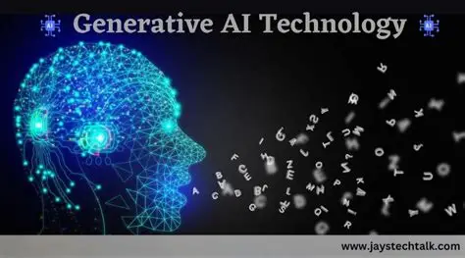
Generative AI
Generative AI is the artificial intelligence which it creates the new contents such as image , text , videos by learning the data

Slide 4
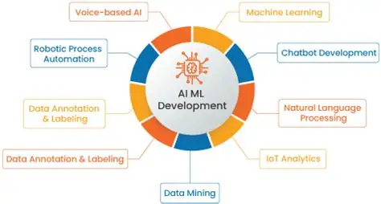
AIML development
Aiml development is all about the machine learning , robotic process automation , data labeling, data mining, iot analytics.

Slide 5
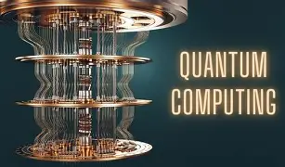
Quantum computing
An area of computer science that uses the principles of quantum theory

Slide 6
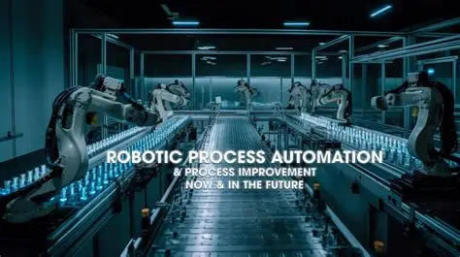
Robotics and automation innovation
It is a inter connected field which the efficiency and productivity across the industries by the technologies to perform task

Slide 7
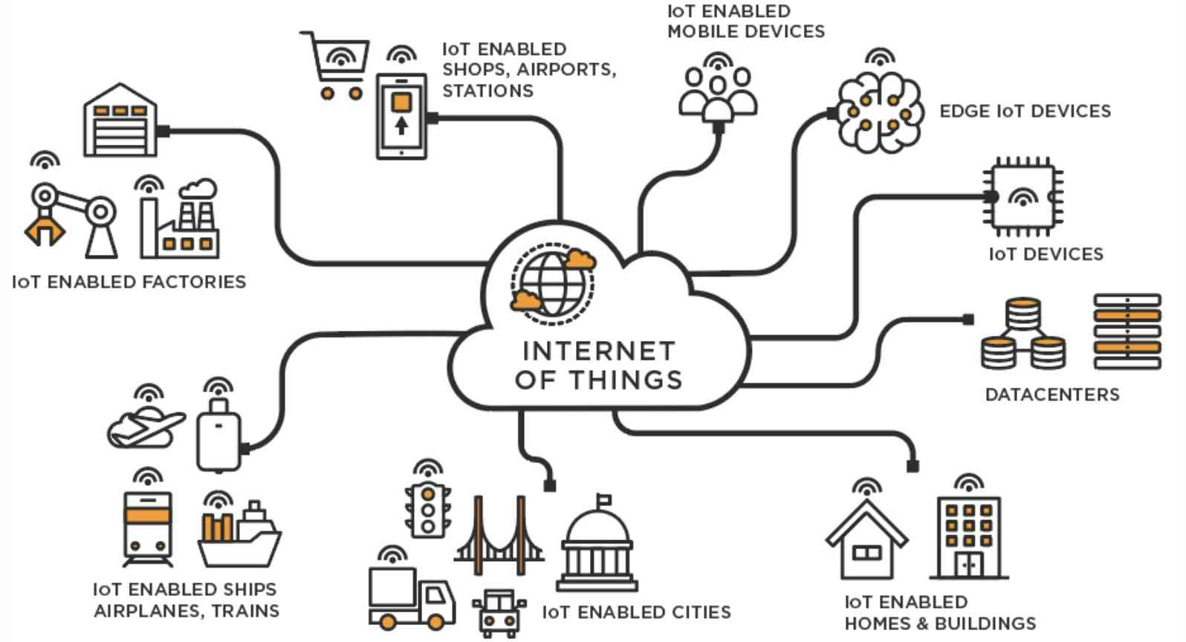
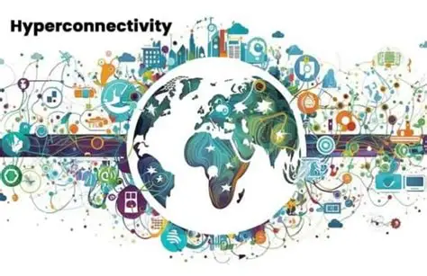
Internet of things and hyper connection
Facilitating seamless communication between devices and connecting more interconnected world

Slide 8
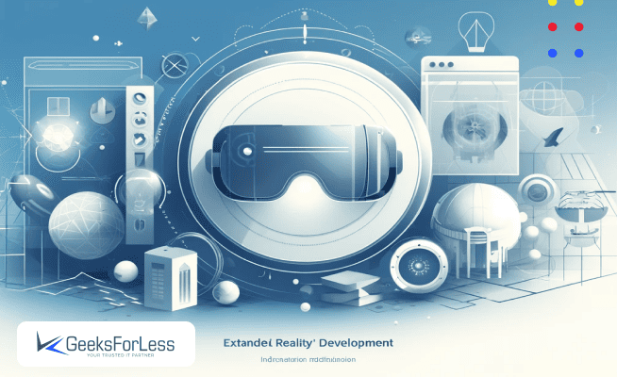
Extended reality – virtual and augmented reality
It creates experience that blend the physical and digital world

Slide 9
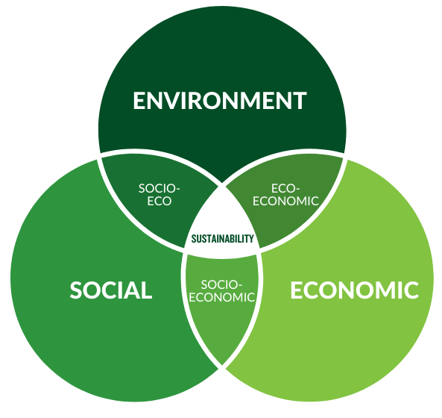
Green and sustainable technologies
Sustainable development is an approach to growth and human development that aims to meet the needs of the present without compromising the ability of future generations to meet their own needs.

Slide 10
Open source google tools
GOOGLE TOOLS | PURPOSE
TENSOR FLOW | MACHINE LEARNING AND DEEP LEARNING FRAME WORK
KUBERNETES | CONTAINER ORCHESTRATION PLATFORM
ANGULAR | WEB FRONT END PROGRAM
FLUTTER | BUILDING NATIVELY COMPILED APPLICATIONS.
BAZEL | BUILD AND TEST TOOL
PROTOCOL BUFFER | DATASERIALIZATION PROJECT
GOOGLE CLOSURE TOOL | JAWA SCRIPIT OPTIMIZATION PROGRAM
GOOGLE CLOUD SDK | TOOLS AND LIBRARIES FOR MANAGING GOOGLE CLOUD RESOURCES.

